Slide 1

THE SIGNAL BENEATH SILENCE
Team Name: ALGO NINJAS
Project Name: Signal Zero – The first trace of something unseen.
Problem Statement: Echos from the visible universe

Slide 2

The Problem & The Mission
Problem Statement Explained:Innovative solution-We built a system that uses structured prompts + Pydantic parsing through LangChain to force Claude to reason step-by-step before giving a classification.By simulating detector data and making Claude analyze it through a scientific lens, we turned a black-box AI into a research partner that can justify its logic — not just output a label.
MISSION: Detect faint dark matter signals hidden within massive detector noise using AI reasoning and scientific logic.The challenge is to distinguish a true cosmic whisper from billions of false echoes.

Slide 3
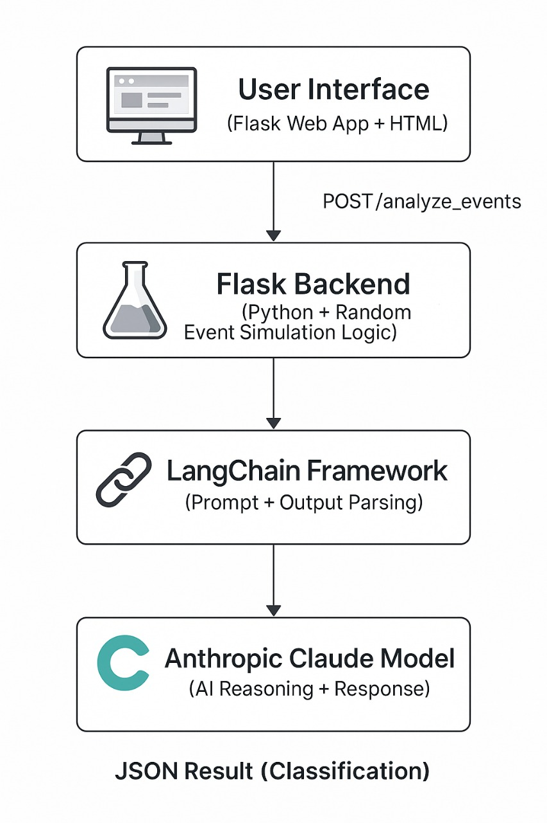
Solution & Architecture
What You have Built: We built an AI-powered system that simulates and analyzes particle detector events to identify potential dark matter signals using reasoning-driven classification.
Frontend: HTML5, CSS3, JavaScript – for user interface and interaction Flask Templates (Jinja2) – to render web pages dynamically Backend: Python (Flask Framework) – for server logic and API routes LangChain – for building structured prompts and managing AI workflowsPydantic – for defining structured AI output schemas dotenv – for secure API key management AI / ML Layer: Anthropic Claude 3 Haiku Model – for reasoning-based classification and explanations Utilities & Toolsre :(Regex) – for JSON text extraction Pandas – for handling event dataOS Random Modules – for simulation and environment handling

Slide 4
Live Demonstration

Slide 5
The Claude Innovation
The Core Challenge: The core challenge in Claude innovation Innovative Solution: Traditional AI models often give answers without explaining why, and in our case, the event data from particle detectors is extremely noisy and uncertain.The challenge was making the model distinguish real dark matter–like events from random background noise, while still providing transparent reasoning behind each decision.

Slide 6
You must use the provided PowerPoint template as it is. Do not modify the template, theme, layout, or any existing design elements. You may adjust the font size, font style, and add additional images if needed. This slide is included only for instructions feel free to delete it after reading.

